Slide 1

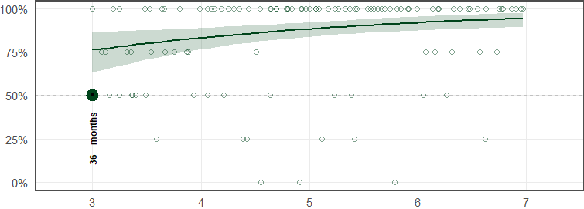
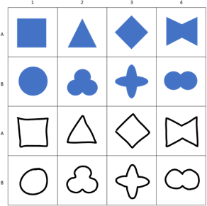

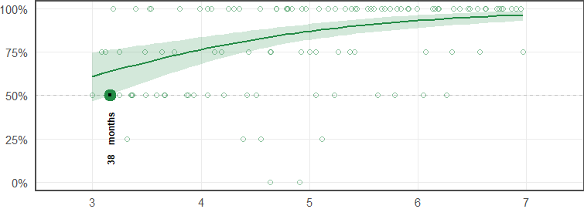
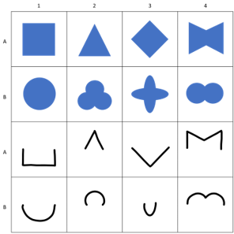

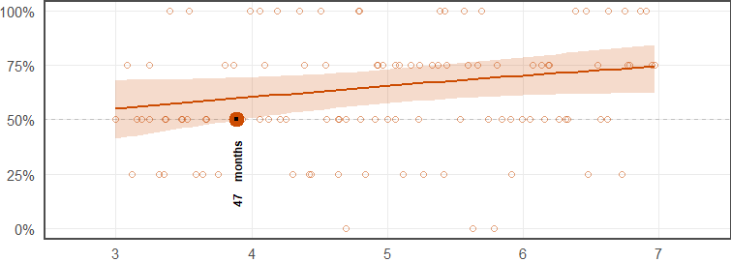
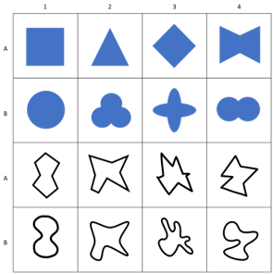

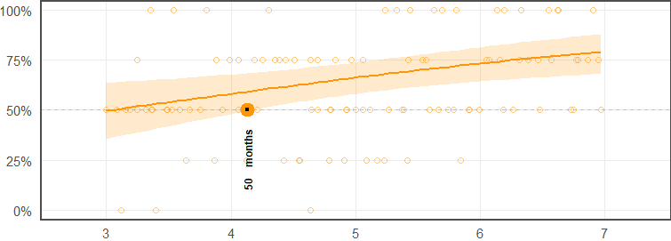
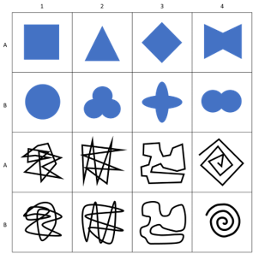

Slide 4
Condition X
Condition X
Condition X
Condition X
Condition X

Slide 5
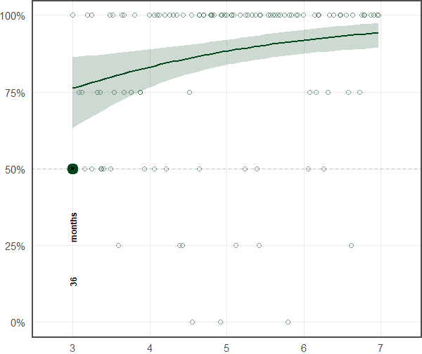
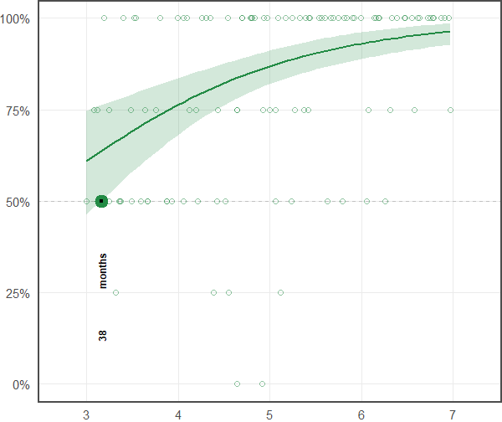
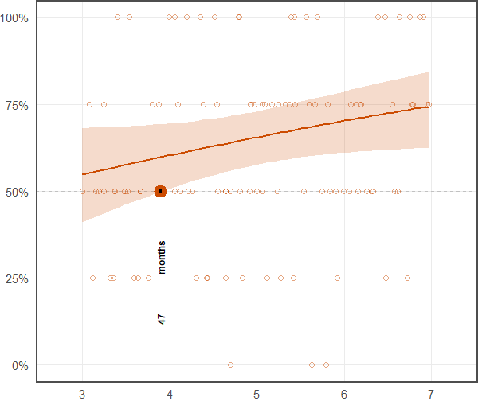
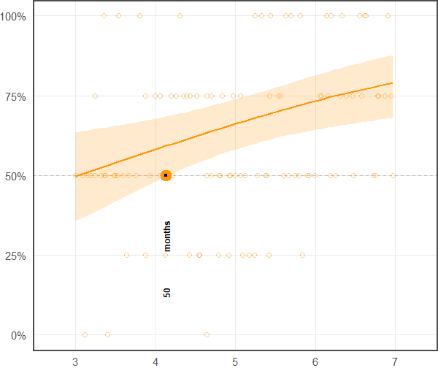
Condition X
Condition X
Condition X
Condition X

Slide 6
Condition X
Condition X
Condition X
Condition X

Slide 7
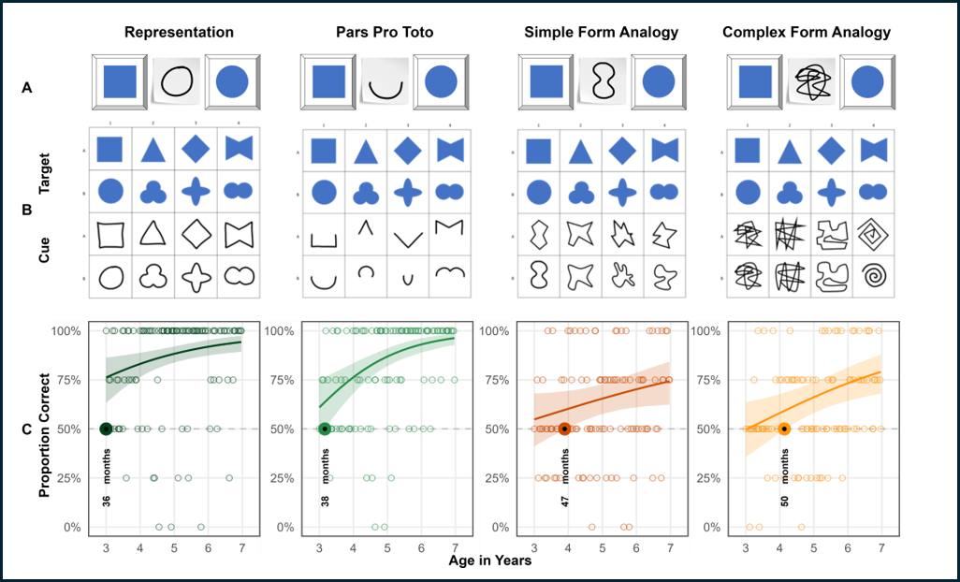
Condition X
Condition X
Condition X
Condition X

Slide 8
Condition X
Condition X
Condition X
Condition X
Condition X
Condition X
Condition X
Condition X

Slide 9
Condition X
Condition X
Condition X
Condition X
Condition X
Condition X
Condition X
Condition X

Slide 10
Condition X
Condition X
Condition X
Condition X
Condition X
Condition X
Condition X
Condition X

